Slide 1
Web50 Section 9
Scalability

Slide 2
Agenda
Notes
Scaling Basics
Examples of Scalability
Questions

Slide 3
Notes
Final Project released: project proposal due Friday April 19th
This is the second to last section

Slide 4


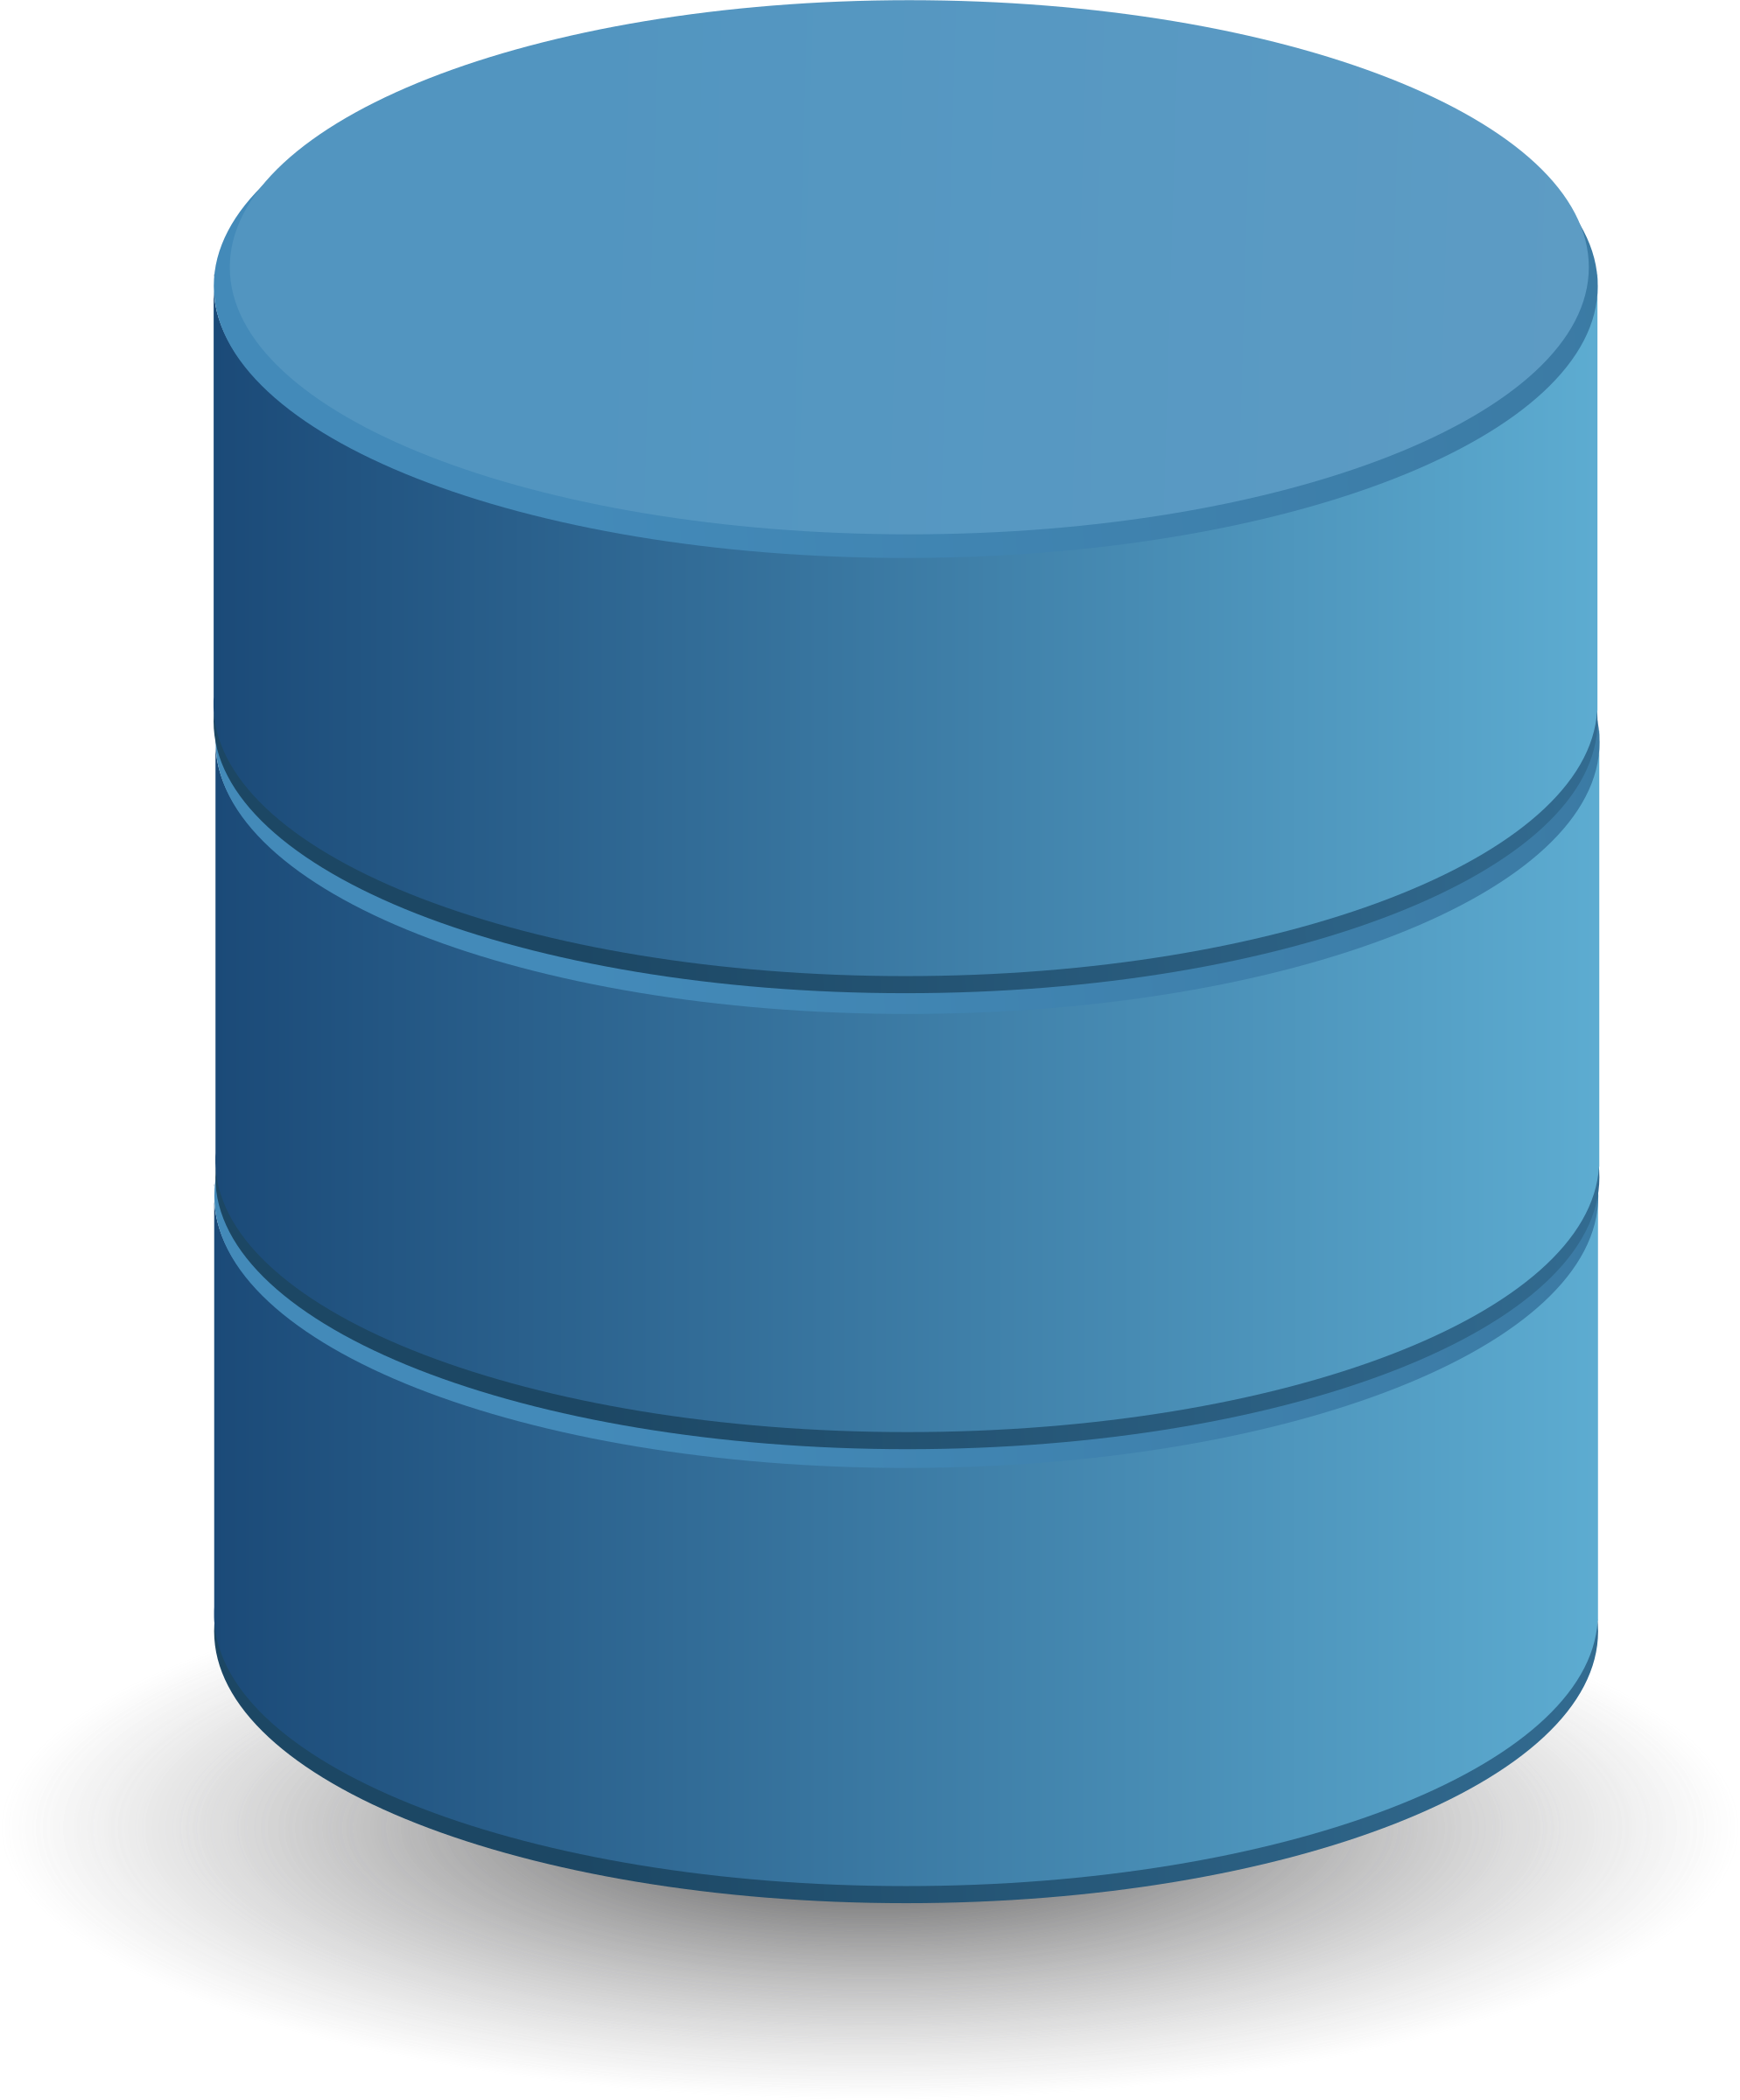
Servers: A review
HTTP Requests
Database
Server
Browsers

Slide 5
Scalability
Benchmarking: Determine out how many requests a server can handle - Load test, stress test
Vertical Scaling: Make the server larger with more processing power - But there is a limit
Horizontal Scaling: Add more servers - Load balancer: hardware used to ensure the user goes to the right server - Load balancing methods: - Random choice - Round robin - Fewest connections - Use: session-aware load balancing to ensure each user uses the same server

Slide 6
Scalability
Autoscaling: Add more servers depending on demand - Also protects against servers going off-line - Common feature of cloud computing: - Servers are located elsewhere and rented out
Database partitioning: Split database into smaller tables to make data access faster - Vertical partitioning: Decrease number of columns - Horizontal partitioning: Decrease number of rows - Database shard: store a different database on a different server

Slide 7
Scalability
Database replication: Allows for multiple access points but need to insure that data is the same across all - Single primary replication: - One database treated as the primary database, with write privileges - Other databases are read only - Multi-primary replication: - Can read and write across any database
Caching: Store data temporarily so you don’t need to call repeat requests - client-side to store page data - sever-side to store the result of database queries

Slide 8
Amazon.com
How would you benchmark Amazon.com?
When would Amazon.com need to vertically scale?
How do you actually “vertically scale”? Where does the new “larger server” come from?
When would Amazon.com horizontally scale?
Amazon.com usually has people spend an equal amount of time on their website. Each user spends ~5 min from searching to checkout.
Which load balancing algorithm makes sense?
Round-robin, random, direct?

Slide 9
Netflix
What load balancing algorithm would Netflix want to use? Some users binge watch 34 hours of TV, while some spend only an hour on the site.
Netflix’s recommendation algorithm is really complicated. When it loads shows for you to watch, how would it want to cache them?
Client-side caching?
Server-side caching?
When would you want to reset the cache?

Slide 10
Gmail Database
Come up with a scheme to vertically scale the Gmail database
Think of users, emails?
Come up with a scheme to horizontally scale the Gmail database
Different users emails?
Emails by time?
When would a slower query time be okay? For what kind of emails?
What is sharding?
What is a single-primary replication system versus a multi-primary replication system?
Does Gmail use a lot of writes or reads or both?

Slide 11
Q&A on Scalability
Questions?

Slide 12
Q&A on Final Project
Potential topics?
Scope?

